Slide 1
Uniform Guidance – Procurement of Goods or Services with Federal Grant Funding
Notes:
The reason for this Zoom invite was to brief our General Counsel’s Office on the contractual requirements set forth by our Federal Procurement Standards so I’m going to go through some of the changes that have occurred, especially as it relates to federally funded projects. Now, Keep in mind that this is not FSU Procurement mandated. This is mandated by the Federal Government and if we don’t follow the standards that they have set, it could not only result in fines to the University but there could be a loss of federally appropriated funding.

Slide 2
When purchasing goods or services, especially with federal funds, the purchase is subject to the Federal Uniform Guidance (UG) and University procurement procedures.
Notes:
When I talk about the Federal Standards I’m talking about The Office of Management and Budget (OMB) and they made several changes to the federal circulars – which are now known as Uniform Guidance (UG). The parts in 2 CFR 200 that contain purchasing changes became effective July 1, 2018 and the Procurement guidance is specifically located in sections 200.317 – 200.326. This is something that all the schools in the U.S. have been trying to really wrap their heads around.
This new guidance focuses on increased competition and transparency in the procurement process and provides procurement actions on what we must do when a procurement is federally funded. We wanted to share with you today so that you would have this information when reviewing contracts that require federal provisions.

Slide 3
Subrecipient-Contractor Determination
A procurement is used to purchase goods or services for the benefit of an award.
A subaward/subcontract/subagreement is used when FSU passes through a portion of an award (received by FSU) to a third party entity who becomes responsible for the programmatic effort of conducting a portion of the project. The federal rules related to a procurement and a subaward differ greatly.
Notes:
One of the first things we do is make a determination as to whether it’s deemed a Procurement contract or a subcontract through the Sponsored Research Office. Federal procurement clauses are used on both procurement contracts and subaward/subcontracts, however, the federal rules related to subcontracts/subawards differ. Therefore, when it’s unclear we work with Sponsored Research to make sure the right determination is made. This slide gives you a brief definition of the difference between a Procurement contract vs. a subcontract/subaward. There is checklist form through the Office of Research that departments can fill out and seek guidance/determination from SRA and if SRA determines it should be a contract through Procurement they send the department over to Procurement Services for sourcing.

Slide 4
Why Is This Important?
Noncompliance with state and federal requirements has serious consequences.
Notes:
So why is it important that we ensure we’re following Uniform Guidance? Well, we’ve not been audited on any procurements yet since the changes took effect, but if we were audited and the federal auditors found we weren’t compliant it could result in
A federal Audit write up and fines
If FEMA related - FEMA Deobligation
Loss of Federal Funding/awards
Disciplinary action, etc.

Slide 5

Top 10 General UG Procurement Standards
Notes:
The following is a summary of the top 10 UG Federal Procurement standards when Procurement is sourcing a procurement request.
These next few slides I’m going to breeze through as you won’t be as much concerned with but I wanted to just give you an idea about UG Procurement Standards.

Slide 6
Contracts funded with federal grant funds must be procured in a manner that conforms with all applicable Federal laws, policies, and standards.”
Notes:
This is from Uniform Guidance within the Procurement Standards.

Slide 7
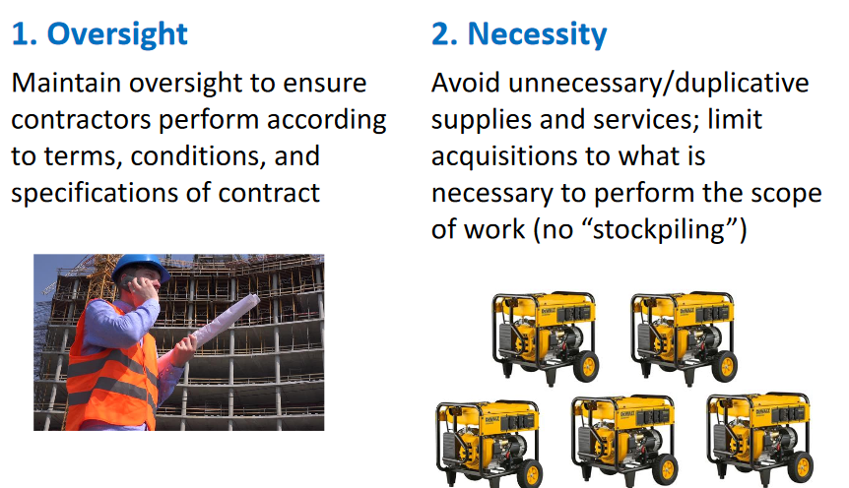
General UG Procurement Standards
Notes:
#1 Oversight – This is pretty self explanatory
#2 Necessity: The Feds want us to avoid acquisition of unnecessary or duplicate items, consider breaking out procurements if it’s more economical or do an analysis of lease vs. purchase and any other actions that make economical sense.

Slide 8
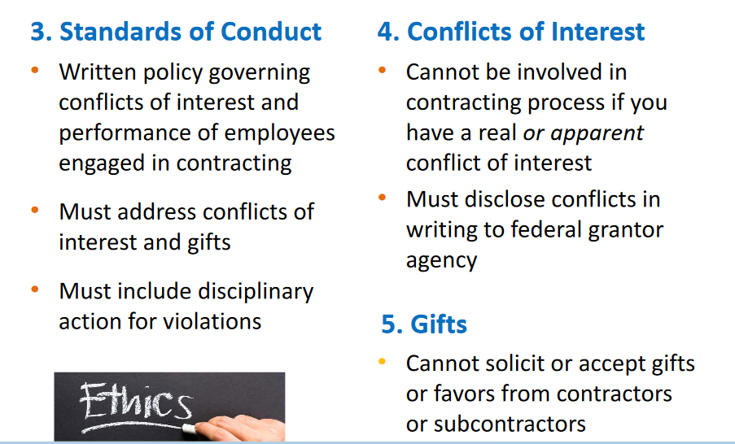
General UG Procurement Standards
Notes:
#3. Standards of Conduct: We currently have a standard of conduct for employees which addresses conduct when engaged in a procurement, conflicts of interests and gifts, etc. I believe we are also in the process of creating a standards of conduct for Suppliers which Rosey can address.
#4. Conflict of Interest: The University’s “staff” Conflict of Interest Policy should be in compliance with UG Procurement Standards. University employees, officers, and agents are directed to review the policy and self-identify conflicts in writing before participating in the selection, award, or administration of a contract. Whenever we do a solicitation we get suppliers to certify there is no conflict and also our PO T&C’s address conflict of interest.
#5. Gifts: Same with Gifts, the policy for employee conflicts of interest also addresses gifts as well.

Slide 9
UG Conflicts of Interest Policy
As part of the OMB’s Uniform Guidance, there are new requirements for conflicts of interest and how the University must handle them. The regulation states:
“No employee, officer, or agent may participate in the selection, award, or administration of a contract supported by a Federal award if he or she has a real or apparent conflict of interest. Such a conflict of interest would arise when the employee, officer, or agent, any member of his or her immediate family, his or her partner, or an organization which employs or is about to employ any of the parties indicated herein, has a financial or other interest in or a tangible personal benefit from a firm considered for a contract.”
Notes:
I just wanted to mention that as part of UG, Conflict of Interest requires increased disclosure of documentation for potential committee members.
Currently for ITN’s we obtain committee member certifications to ensure there are no conflicts of Interest, However, sole source justifications may require further evidence or statements assuring that no financial relationship exists with potential suppliers when federally funded. With UG they want to make sure there isn’t any individual or “organizational” conflicts of interest.

Slide 10
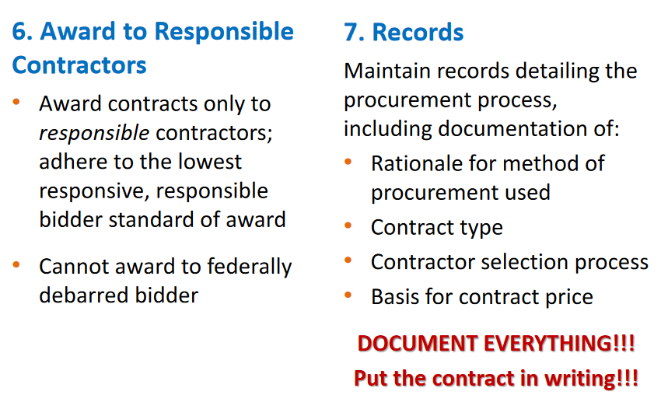
General UG Procurement Standards
Notes:
#6. Award to Responsible Contractors:
Purchase orders and/or contracts currently state they will only be issued to or awarded to responsible contractors possessing the ability to perform successfully under the terms and conditions of the proposed procurement. We have language in all our solicitations regarding this and in addition AP is in the process of implementing Visual Compliance – Go live is Aug. 6th or 7th. Visual Compliance provides restricted party compliance screenings as the U.S. law restricts interaction with all individuals and companies on a U.S. government list for debarred, restricted or denied entities. Failure to comply can result in fines, prosecution and the inability to receive any federal funding. Additionally, each time a proposal is submitted for a federal grant we have to certify that we are not in violation of these laws. The only way to provide certainty is through screening.
#7. Records: Procurement is required to maintain records sufficient to detail the history of each procurement and files with the Purchase Order all associated documents. (e.g. price quotes, product specifications, the solicitation forms, competitive solicitation requirements/forms scope of work, etc.). The Contract document would be housed in the SpearMart Contract Module.

Slide 11
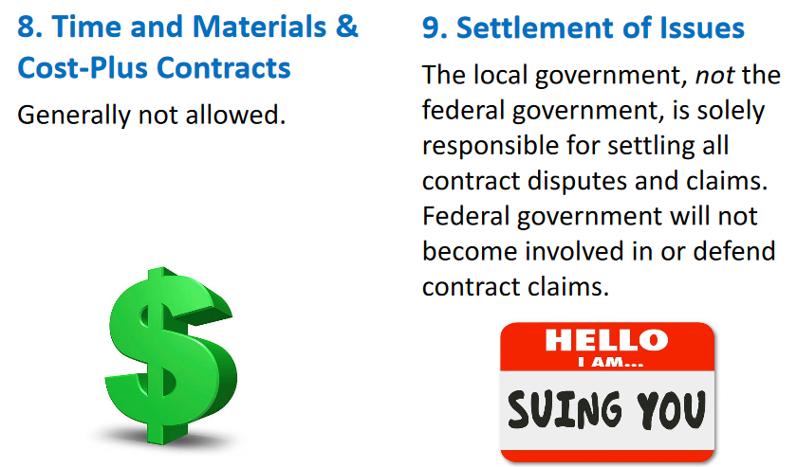
General UG Procurement Standards
Notes:
#8. Time and Materials & Cost-Plus Contracts: Contracts must be for a fixed-price (lump sum, not-to-exceed, etc.)
Cost-plus contracts are not allowed
Time & Materials may be allowed in some circumstances within a limited time frame and the contract is to include a not-to-exceed limit.
#9. Settlement of Issues: Procurement, in conjunction with Legal, are responsible for the settlement of all contractual and administrative issues arising out of procurements. Basically the feds say that they will not be involved in or defend contract claims.

Slide 12
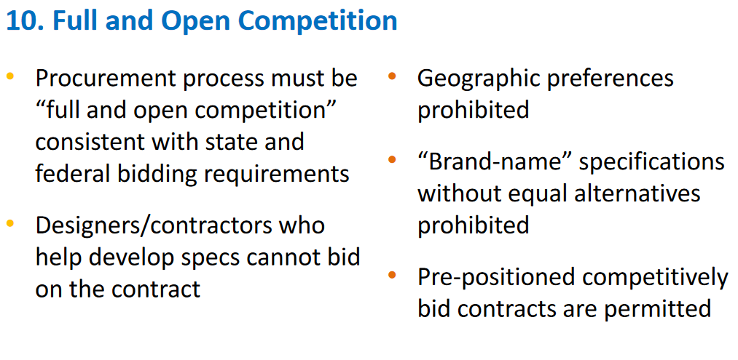
General UG Procurement Standards
Notes:
#10.Full and open competition: The procurement process must be competitive and transparent according to our laws and regulations and contractors/suppliers that help to develop specs are excluded from competition (both in our FSU Procurement Regulations, BOG Regulation and Florida Statute).
In addition, under UG when using federal funds, we are not allowed to stipulate geographic preferences, or list brand names without providing for equal alternatives.
However, Pre-positioned competitively bid contracts are permitted. An example of this would be where we put out for bid ahead of a disaster, and award a disaster recovery contract for services that covered water mitigation, tree removal, debris removal, etc.

Slide 13
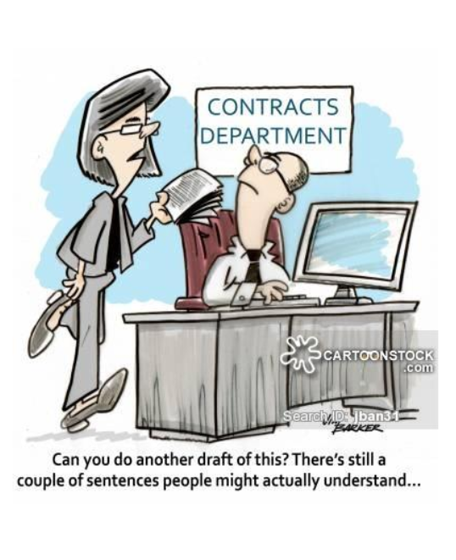
Contract Provisions
Notes:
In addition to the University’s Standard Terms and Conditions, University contracts utilizing Federal funding must also contain the applicable provisions described in Appendix II to Part 200: Contract Provisions of UG.

Slide 14

UG Contract Provisions:
Contracts must contain certain “boilerplate” provisions
Must have provisions in writing in some form
Requirements vary depending on cost of the contract
Can include in standard T&Cs
Can include in bid specs for suppliers to certify contract when submitting bids
Notes:
Also, In addition, to UG the grantor agency or federal award entity may require additional provisions. Oftentimes these are already included in the bid specs.

Slide 15
Contract Provisions Cont.
Others:
Changes and modifications to contract
Access to records
Compliance with federal law, regulations, and executive orders
Federal government hold-harmless
Fraud and False Statements
Notes:
And this is just an example of other required federal clauses that must be in the agreement. Usually the Federal Award agency will tell us what they require.

Slide 16
UG Requires Contract Provisions On:
Remedies for breach
2. Termination for cause and convenience
3. EEO
4. Bacon-Davis wage requirements
5. Work Hours and Safety Standards
Notes:
Contracts for more than the UG simplified acquisition threshold currently set at $150,000, must address administrative, contractual, or legal remedies in instances where contractors violate or breach contract terms, and provide for such sanctions and penalties as appropriate.
All contracts in excess of $10,000 must address termination for cause and for convenience including the manner by which it will be effected and the basis for settlement.
EEO: we currently have as part of our Master Contract template (this must also be in all federally assisted construction contracts.
All prime construction contracts in excess of $2,000 must include a provision for compliance with the Davis Bacon Act. In addition, contracts must also include a provision for compliance with the Copeland Anti-Kickback Act.
Contract Work Hours and Safety Standards Act (> $100,000 where mechanics or laborers are used)

Slide 17
UG Requires Contract Provisions On:
6. Clean Air Act and Federal Water Pollution Control Act
7. Debarment and Suspension
8. Byrd Anti-Lobbying
9. Recovered Materials
10. Rights to Inventions Made Under a Contract or Agreement
Notes:
6. Clean Air and Federal Water Pollution Control Act (> $150,000)
7. Debarment and Suspension: A contract cannot be made to parties listed on the governmentwide exclusions in the System for Award Management (SAM).
8. Byrd Anti-Lobbying: (> $100,000) – contractors must file the required certification.
9. Recovered Materials: Where the purchase price of an item exceeds $10,000 or the value of the quantity acquired during the preceding fiscal year exceeded $10,000, contractors shall make max. use of products containing recovered materials that are EPA designated items…
10. Rights to Inventions: If the Federal Award meets the definition of “funding agreement” and the recipient or subrecipient wishes to enter into a contract with a small business firm or nonprofit organization regarding the substitution of parties, assignment or performance of experimental, developmental, or research work … must comply with 37 CFR Part 401.

Slide 18
This is where we need your help
Procurement will need to work closely with General Counsel when procurements are federally funded to ensure required clauses are applied to contracts.
Notes:
This is where we need your help to ensure we are in compliance with federal procurement standards (UG), especially when it’s a federally funded contract, when using our contract templates. Normally you all are really great when it comes to notifying us that you’ve received a contact document concerning a procurement but we wanted to make you aware of these things just so we ensure we are all including required clauses in any federal funded agreements.

Slide 19
Contract Provisions listed in Appendix II to Part 200
2CFR Procurement Standards
Or
https://www.ecfr.gov/cgi-bin/ECFR?page=browse
Notes:
This is where you can see the Uniform Guidance Procurement Standards.
With regards to the required clauses, we already have a contract amendment or attachment that we use for FEMA purchases that lists all these clauses I mentioned so we can easily add to other federally funded contracts as well.

Slide 20
Questions?

